Slide 1



Aim & Objectives of the study
Aim:
To Design & Develop Smart Robotic System for Agricultural Application.
Objectives:
To Design Plant Disease Detection System Using Machine Learning Technique.
To Develop Robotic System for Plant Monitoring, Disease Detection and Pesticide Sprinkling Management with Internet of Things Technique.
To Design Android/Web Based Platform for Robotic Control, Plant Disease Detection Analysis and Pesticide Sprinkling System Control in IoT Environment.

Slide 2
Block Diagram of Proposed Smart Farming System
Proposed Work: Methodology
Power Source
Collection of Real-Time Data
Plant Disease Detection System
Data Collection
Data Processing
Machine/ Deep Learning Algorithms
Data Monitoring and Robot Controlling in IoT Environment
(Web Based Portal/Android Application)
Smart and Intelligent Action by Robot
Advanced Controlling System
Web Based Platform
Robot Control & Disease Detection Statistics Analysis
Camera
Raspberry Pi 4
Trained with designed Deep Learning Model
(10000 Tomato Leaf Dataset)
Wireless Communication Over Internet
Robot Assembly
Motors, Drivers & Relays
Pesticide Model
Solenoid Valve, Ultrasonic Sensor, Sprinkler

Slide 3
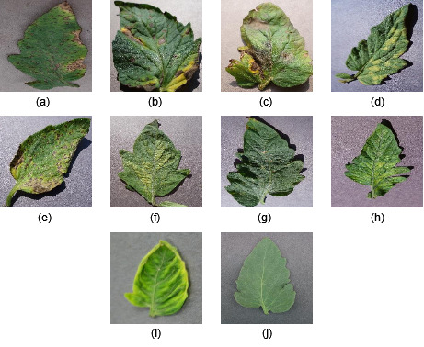
Sample Images of Diseased and Healthy Leaves of Tomato Plant
Bacterial Spot (b) Early Blight (c) Late Blight (d) Leaf Mold (e) Septoria Leaf Spot
(f) Spider Mite (g) Target Spot (h) Mosaic Virus (i) Yellow Leaf Curl Virus (j) Healthy Leaf

Slide 4
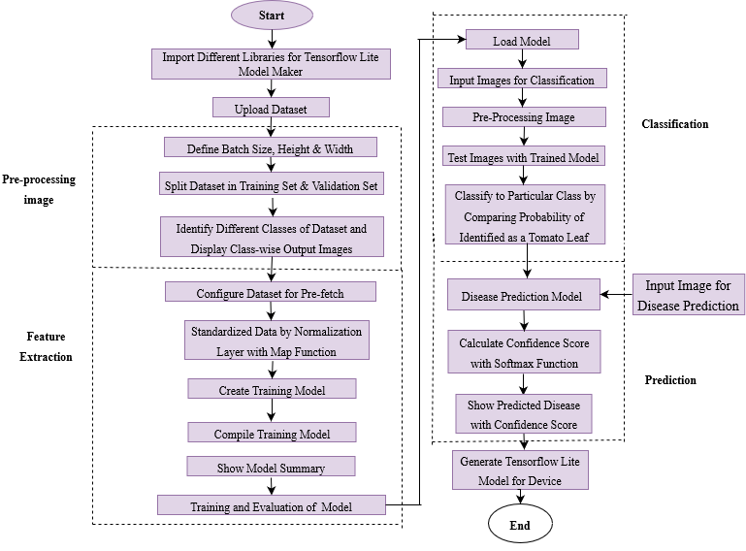
Proposed Plant Disease Detection Algorithm

Slide 5
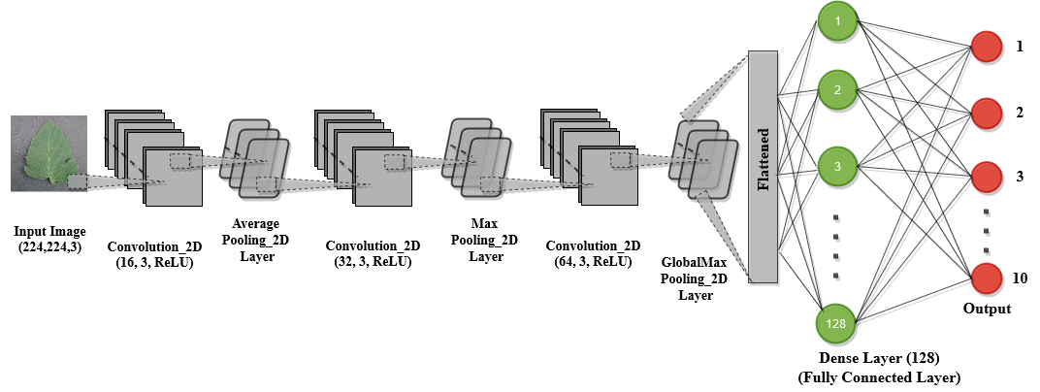
Proposed CNN Model Architecture

Slide 6
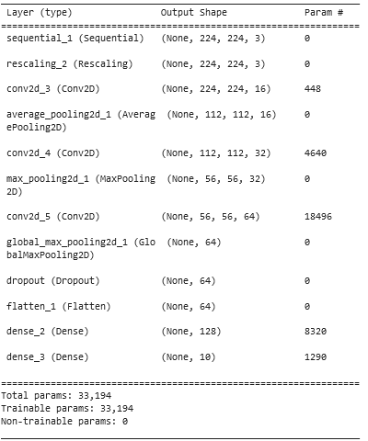
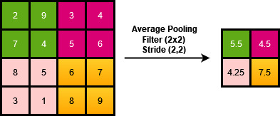
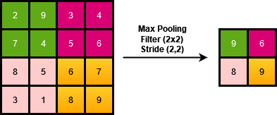
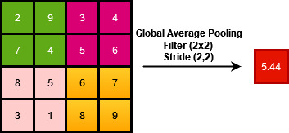
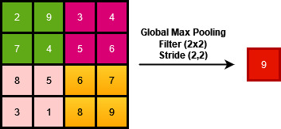
Model Summary
Pooling Techniques in CNN
Training Model Framework Approaches
Pooling Layer | Different Training Models
 | Model_1 | Model_2 | Model_3 | Model_4
Pooling Layer_1 | Max_ Pooling | Average_ Pooling | Average_ Pooling | Max_ Pooling
Pooling Layer_2 | Max_ Pooling | Max_ Pooling | Max_ Pooling | Max_ Pooling
Pooling Layer_3 | Max_ Pooling | Max_ Pooling | Global_Max_ Pooling | Average_ Pooling

Slide 7
Comparative Performance Analysis of Different Training Models Framed
Loss Analysis of Training Model Framework Approaches
Accuracy Analysis of Training Model Framework Approaches
Epoch | Model_1 |  | Model_2 |  | Model_3 |  | Model_4
 | Training _Loss | Validation_Loss | Training _Loss | Validation_Loss | Training _Loss | Validation_Loss | Training _Loss | Validation_Loss
1 | 143.09 | 93.09 | 158.14 | 88.99 | 207.43 | 177.71 | 156.29 | 94.73
2 | 76.88 | 102.1 | 78.05 | 65.79 | 138.48 | 109.11 | 80.75 | 65.71
3 | 53.44 | 110.52 | 55.03 | 40.17 | 101.23 | 72.47 | 68.7 | 52.31
4 | 45.29 | 100.47 | 43.15 | 34.61 | 81.55 | 55.25 | 51.64 | 53.02
5 | 35.58 | 129.26 | 37.52 | 47.9 | 68.88 | 52.24 | 43.91 | 87.2
6 | 33.86 | 94.55 | 34.3 | 23.03 | 62.69 | 40.86 | 42.15 | 51.37
7 | 30.17 | 189.65 | 28.82 | 25.51 | 57.55 | 34.92 | 35.8 | 46.59
8 | 27.21 | 105.28 | 27.23 | 57.11 | 49.97 | 30.98 | 35.99 | 56.63
9 | 25.15 | 87.97 | 25.59 | 34.05 | 48.06 | 28.98 | 30.75 | 42.69
10 | 23.15 | 34.12 | 21.88 | 20.36 | 46.16 | 24.45 | 27.54 | 50.95
11 | 21.62 | 83.84 | 24.68 | 45.63 | 42.44 | 24.66 | 26.03 | 33.49
12 | 20.86 | 127.58 | 20.28 | 14.69 | 39.08 | 21.81 | 23.92 | 65.07
13 | 20.02 | 69.02 | 18.76 | 22.89 | 37.28 | 18.44 | 27.8 | 41.51
14 | 17.14 | 172.24 | 18.4 | 21.66 | 36.9 | 37.21 | 25.3 | 51.69
15 | 16.05 | 38 | 17.42 | 18.19 | 34.13 | 18.54 | 22.22 | 37.27
16 | 16.87 | 183.06 | 16.07 | 26.75 | 32.87 | 21.62 | 21.08 | 41.14
17 | 15.22 | 58.97 | 16.54 | 15.11 | 31.21 | 26.85 | 20.22 | 49.15
18 | 14.45 | 62.23 | 16.12 | 20.35 | 31 | 20.8 | 18.59 | 47.4
19 | 16.19 | 38.57 | 12.76 | 21.13 | 29.44 | 26.88 | 17.52 | 37.51
20 | 15.43 | 73.38 | 13.66 | 22.14 | 28.88 | 12.61 | 21.58 | 35.76
Pooling Layer/Model | Model_1 | Model_2 | Model_3 | Model_4
PoolingLayer_1 | Max_Pooling | Average_Pooling | Average_Pooling | Max_Pooling
PoolingLayer_2 | Max_Pooling | Max_Pooling | Max_Pooling | Max_Pooling
PoolingLayer_3 | Max_Pooling | Max_Pooling | Global_Max_Pooling | Average_Pooling
Epoch | Model_1 |  | Model_2 |  | Model_3 |  | Model_4
 | Training_Accuracy | Validation_Accuracy | Training_Accuracy | Validation_Accuracy | Training_Accuracy | Validation_Accuracy | Training_Accuracy | Validation_Accuracy
1 | 50.28 | 69.39 | 43.82 | 70.41 | 27.73 | 32.65 | 45.74 | 71.43
2 | 74.2 | 62.76 | 72.1 | 80.1 | 65.19 | 60.71 | 72.29 | 78.57
3 | 81.49 | 67.35 | 80.81 | 88.78 | 76.48 | 78.06 | 76.88 | 83.16
4 | 84.4 | 72.96 | 84.71 | 86.73 | 82.59 | 82.65 | 81.96 | 82.65
5 | 87.79 | 68.88 | 87.05 | 84.18 | 85.65 | 82.65 | 84.84 | 72.96
6 | 87.93 | 71.43 | 88.13 | 93.37 | 87.01 | 86.73 | 85.51 | 83.16
7 | 89.45 | 59.69 | 89.45 | 93.37 | 89.1 | 89.8 | 87.75 | 83.67
8 | 90.49 | 70.92 | 90.55 | 84.69 | 91.16 | 92.35 | 87.15 | 84.69
9 | 90.83 | 76.02 | 91.25 | 88.78 | 91.56 | 90.31 | 89.11 | 84.69
10 | 92.03 | 88.27 | 92.18 | 94.9 | 91.98 | 93.37 | 90.05 | 85.71
11 | 92.59 | 77.04 | 91.35 | 85.71 | 93.43 | 92.35 | 90.9 | 89.8
12 | 93 | 69.39 | 92.63 | 96.43 | 93.03 | 91.84 | 91.64 | 82.65
13 | 93.13 | 80.1 | 93.56 | 91.84 | 94.91 | 93.37 | 90.68 | 84.69
14 | 94.19 | 67.35 | 93.48 | 93.37 | 94.43 | 87.76 | 91.33 | 84.69
15 | 94.15 | 91.33 | 93.86 | 93.37 | 93.59 | 94.39 | 92.19 | 88.27
16 | 94.28 | 62.76 | 94.46 | 92.86 | 95.13 | 93.88 | 92.68 | 86.73
17 | 94.95 | 83.16 | 94.28 | 95.41 | 95.65 | 90.82 | 93.05 | 85.2
18 | 94.83 | 84.18 | 94.23 | 92.35 | 95.79 | 93.88 | 93.36 | 85.71
19 | 94.4 | 89.8 | 95.6 | 93.37 | 95.61 | 91.33 | 94.05 | 87.76
20 | 94.91 | 81.63 | 95.16 | 91.84 | 96.96 | 95.41 | 92.43 | 88.27
Model | Performance Measures
 | Train_Loss | Validation_Loss | Train_Accuracy | Validation_ Accuracy
Model_1 | 15.43 | 73.38 | 94.91 | 81.63
Model_2 | 13.66 | 22.14 | 95.16 | 91.84
Model_3 | 28.88 | 12.61 | 96.96 | 95.41
Model_4 | 21.58 | 35.76 | 92.43 | 88.27

Slide 8
Comparative Performance Analysis of Different Training Models Framed
Pooling Layer/Model | Model_1 | Model_2 | Model_3 | Model_4
PoolingLayer_1 | Max_Pooling | Average_Pooling | Average_Pooling | Max_Pooling
PoolingLayer_2 | Max_Pooling | Max_Pooling | Max_Pooling | Max_Pooling
PoolingLayer_3 | Max_Pooling | Max_Pooling | Global_Max_Pooling | Average_Pooling
Model | Performance Measures
 | Train_Loss | Validation_Loss | Train_Accuracy | Validation_ Accuracy
Model_1 | 15.43 | 73.38 | 94.91 | 81.63
Model_2 | 13.66 | 22.14 | 95.16 | 91.84
Model_3 | 28.88 | 12.61 | 96.96 | 95.41
Model_4 | 21.58 | 35.76 | 92.43 | 88.27

Slide 9
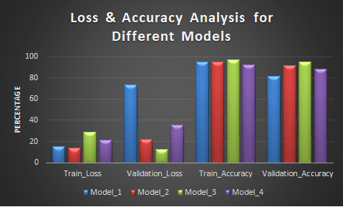
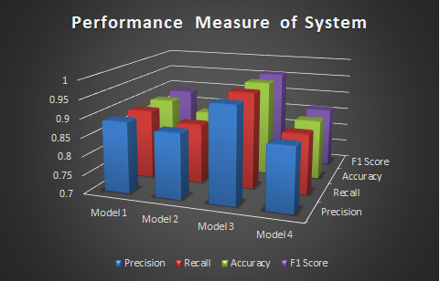
Comparative Performance Analysis of Different Training Models Framed

Slide 10
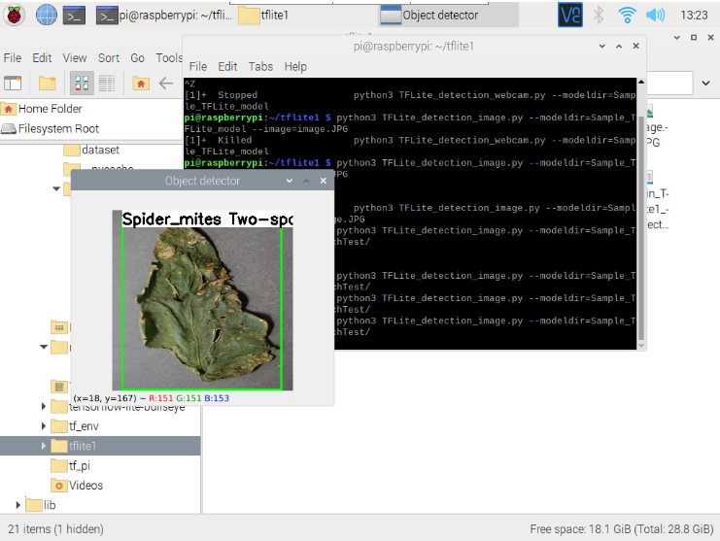
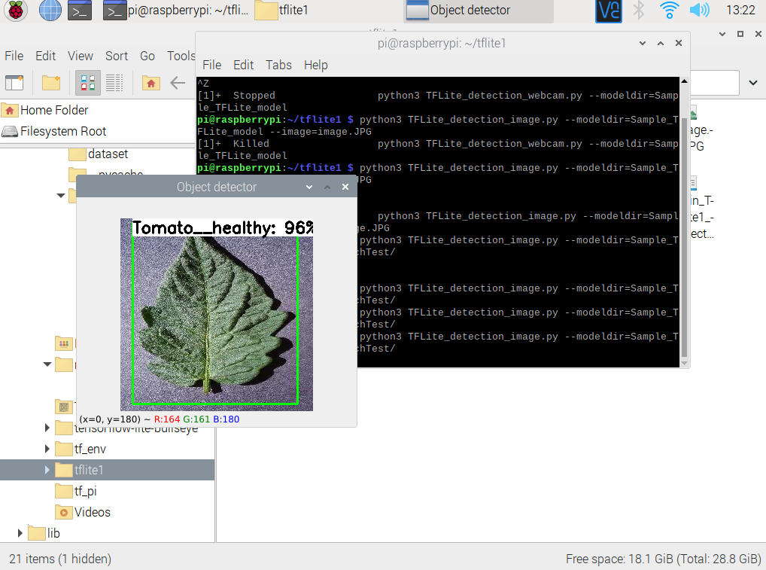
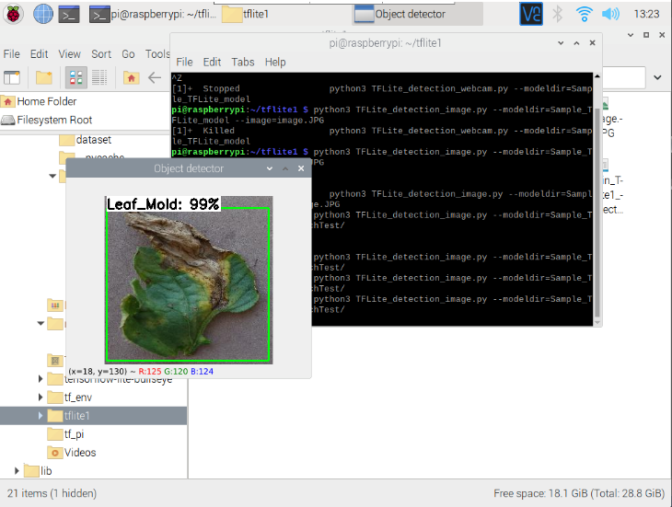
Model Testing with Dataset Images

Slide 11
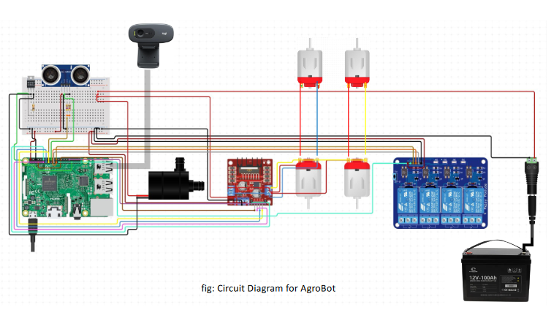
Robotic System Work Flow Diagram
Power ON Robotic System Through Web Control
Pesticide Sprinkling System Activated As Per Disease Detected
SYSTEM CONFIGURATION
Circuit Diagram
Robot Moves Forward on Predefined Path for Defined Distance
Robot Moves Reverse and Forward while Sprinkling Pesticide
Libraries/Software: - Raspberry Pi OS Raspberry Pi Imager VNC Viewer TensorFlow Tflite Flask Server OPENCV Python | Hardware Used: - Raspberry Pi 4 4 GB RAM SD card 16 Gb Camera (5MP) LCD Screen Relay DC Motors and Drivers Ultrasonic Sensor Solenoid Valve Pump Pesticide Tank Spraying Nozzle Battery/Power Bank
Camera Captured Leaf Samples to Detect Disease
Robotic System Send Pesticide Tank and Disease Detection Status to Web Panel Over Internet
Disease Detected?
Yes
Robot Comes Back to Original Position and updated Status to Web System
No
No
Robot Reached Destination?
Power OFF Robot Through Web Control System
Yes

Slide 12
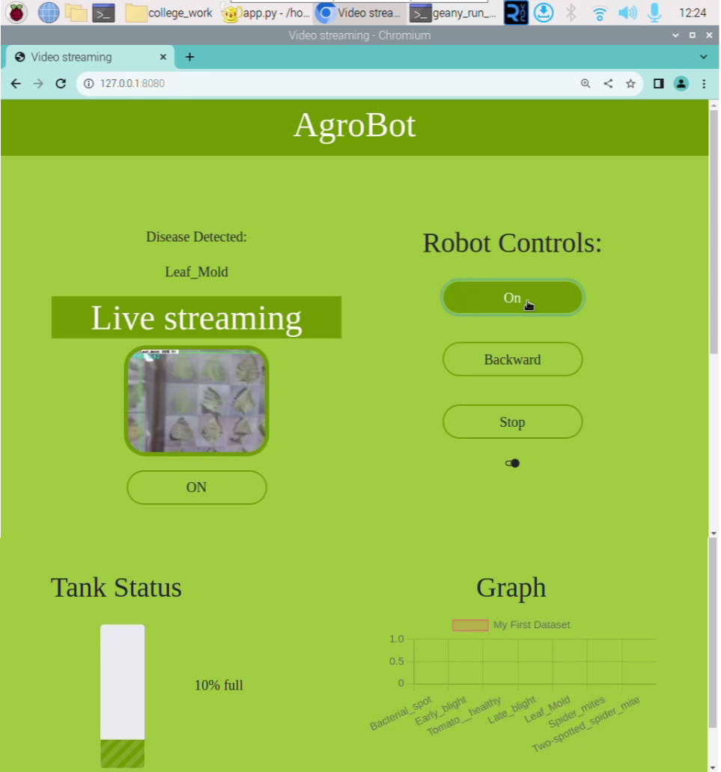
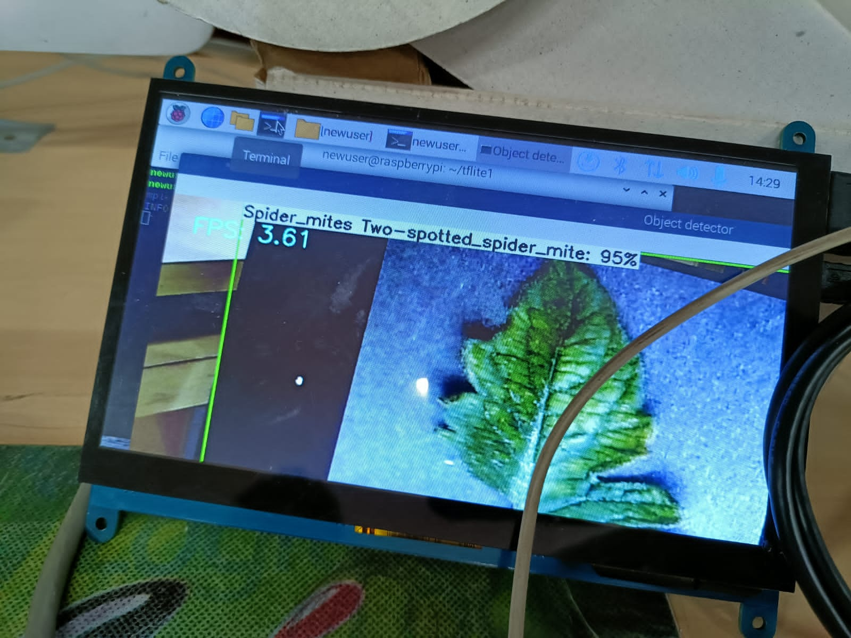
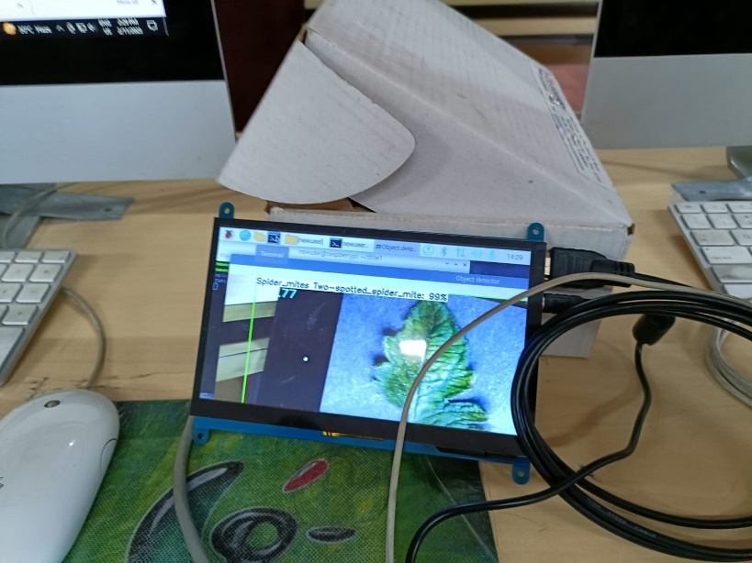
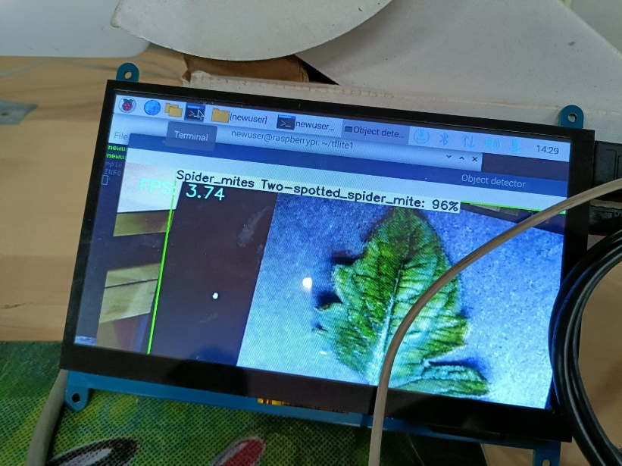
Web Page for IoT Environment
Model Validation with Hardware

Slide 13
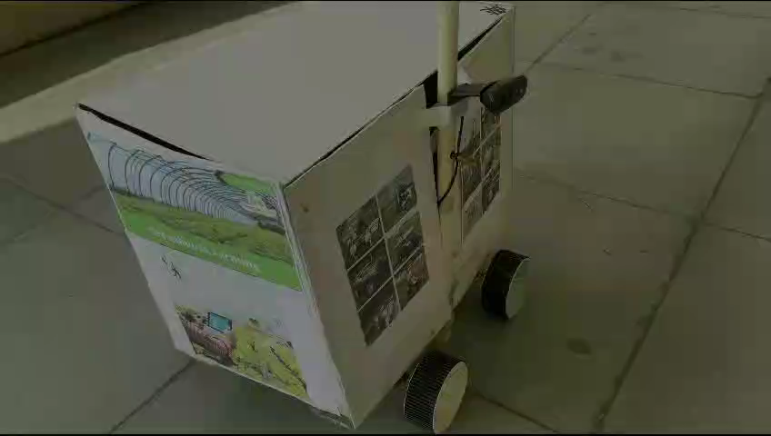
System Testing and Validation

